Slide 1

About team | Problem Statement | Project Overview | Dataset | Architecture | ML Model | Output | Conclusion
JOBfit.
SUMMER TRAINING PROJECT

Slide 2


About team | Problem Statement | Project Overview | Dataset | Architecture | ML Model | Output | Conclusion
About Team
GROUP 08
SOUMYA SONEJA 2401020061
DHRUVI SHARMA 992401030276
ANSHIKA SRIVASTAV 2405170095
AARUSH BAHUGUNA 2401200026

Slide 3
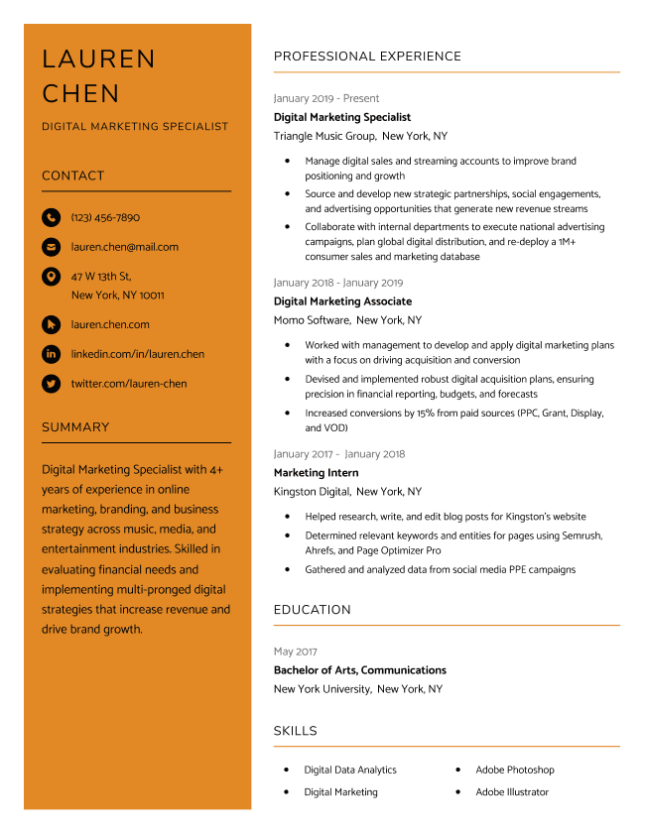
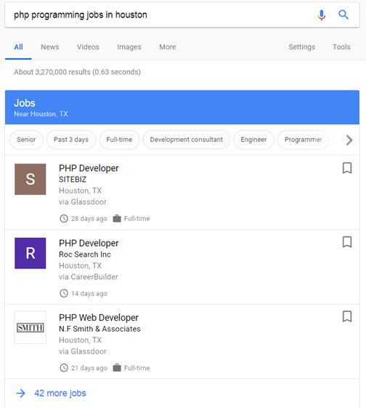


About team | Problem Statement | Project Overview | Dataset | Architecture | ML Model | Output | Conclusion
Problem Statement
Despite the growing availability of online learning resources and career guidance tools, professionals and students often struggle to identify the exact skills they lack for transitioning into their desired job roles. Traditional methods rely heavily on self-assessment or generic advice, which may not accurately reflect the real-world expectations of a job market. There is a critical need for a data-driven system that can analyze individual resumes, compare them with industry-aligned profiles, and automatically detect missing skills—enabling users to take focused, actionable steps in their career development.

Slide 4

About team | Problem Statement | Project Overview | Dataset | Architecture | ML Model | Output | Conclusion
OBJECTIVE :
To bridge the gap between resumes and job descriptions by identifying missing and advanced skills in resumes, recommending personalized resources, and evaluating candidate-job fit using intelligent ranking and visualization techniques.
Overview
Key Features :
Resume preprocessing and cleaning
Automatic detection of skill gaps
Similarity-based job ranking
Radar and bar chart visual feedback
Skill recommendations with project + course links
Ranking metric evaluation (Precision, Recall, F1, MAP, NDCG)
Career trajectory prediction based on job role
SOLUTION : We developed a web-based Skill Gap Analyzer that:
Accepts resumes via text or file upload.
Compares them with job descriptions using ML and IR techniques.
Visualizes skill gaps using radar and bar charts.
Provides recommendations with skill-tagged resources.
Evaluates performance using ranking metrics.
Technical Stack :
Frontend: HTML + Flask templates (render_template_string)
Backend: Python (Flask Web Framework)
ML Libraries: Scikit-learn, NumPy, pandas
IR Techniques: TF-IDF Vectorization + Cosine Similarity
Modelling: Logistic Regression
Visualization: Matplotlib (Radar + Bar Charts)

Slide 5
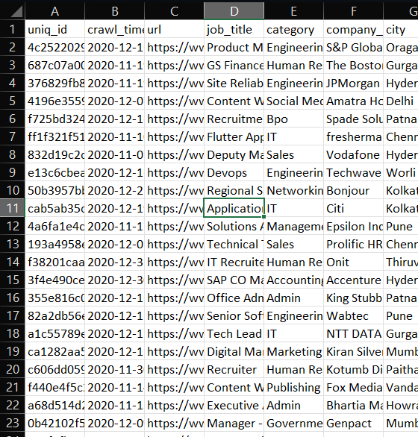
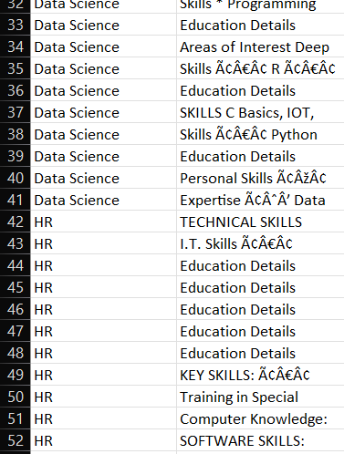


About team | Problem Statement | Project Overview | Dataset | Architecture | ML Model | Output | Conclusion
DATASETs USED
Job Dataset: job_postings.csv
Contains job listings with descriptions and job titles
Column used: job_description
Cleaned similarly to resume text
Used for:
Extracting required job skills
Matching resumes via cosine similarity
Resume Dataset: UpdatedResumeDataSet.csv
Contains real-world resumes with categories (e.g., Data Science, HR, etc.)
Column used: Resume
Cleaned using regular expressions and punctuation removal
Used for:
Analyzing candidate skill sets
Training match classification model
Dataset Stats.
1000+ resumes
2000+ job descriptions
Coverage: Technical and non-technical roles

Slide 6
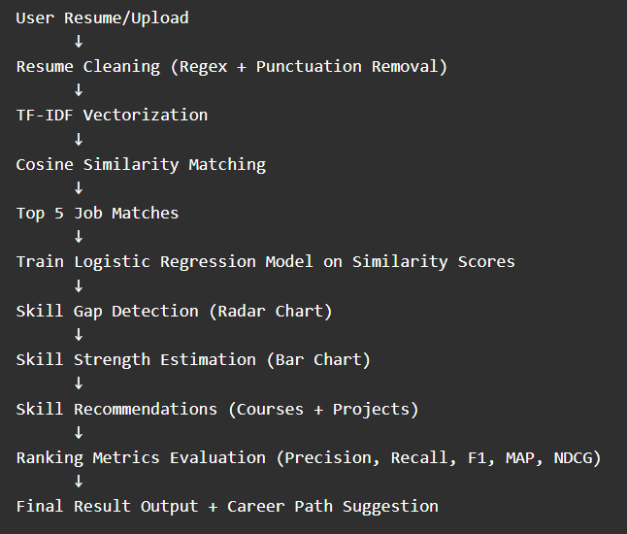
About team | Problem Statement | Project Overview | Dataset | Architecture | ML Model | Output | Conclusion
Step-by-Step Architecture Overview
Input Layer:
Resume Text / File Upload (txt)
Preprocessing Module:
Clean Resume + Job Descriptions (HTML tags, lowercase, punctuation)
Feature Extraction:
TF-IDF Vectorization (Resume & Job Descriptions)
Similarity Engine:
Cosine Similarity to Rank Jobs
Classifier Model:
Logistic Regression Model (Trained on similarity threshold)
Visualization Module:
Radar Chart: Skill vs Job Requirement
Bar Chart: Skill Strength Estimation
Recommendation Engine:
Identify missing/advance skills
Fetch course + project links
Evaluation Engine:
Compute Ranking Metrics: Precision, Recall, F1, MAP, NDCG
Frontend Output:
Job match table
Charts + Metrics
Skill-based learning suggestions
Career Trajectory

Slide 7
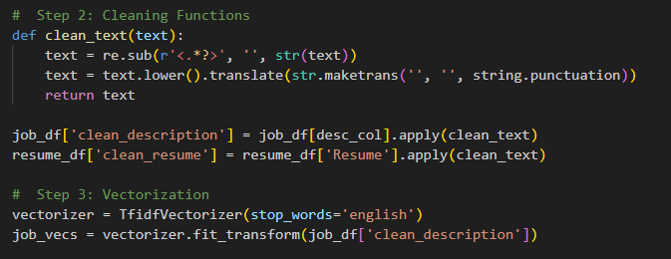
About team | Problem Statement | Project Overview | Dataset | Architecture | ML Model | Output | Conclusion
Text Cleaning +
TF-IDF
Text Preprocessing
Raw resume and job description text often contains:
HTML tags, symbols, punctuation, inconsistent casing
We use a clean_text() function to:
Remove HTML (<.*?>)
Lowercase the text
Remove punctuation
Ensures the text is in a consistent format for ML processing
TF-IDF Vectorization
TF-IDF = Term Frequency – Inverse Document Frequency
Converts cleaned text into numerical vectors
Measures how important a word is in a document relative to a collection of documents
Captures the uniqueness of skills/terms in resumes and job descriptions
Helps identify key similarities and differences

Slide 8
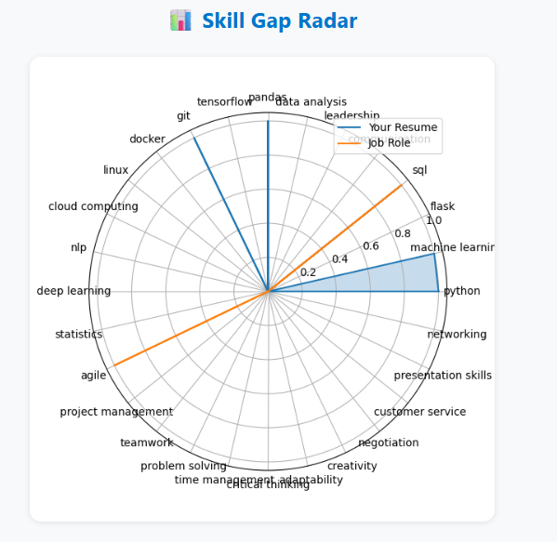
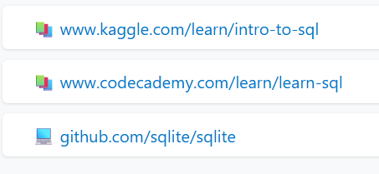
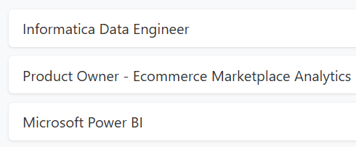

About team | Problem Statement | Project Overview | Dataset | Architecture | ML Model | Output | Conclusion
Logistic Regression Model
After computing cosine similarity between resume and job descriptions:
A Logistic Regression model predicts if the resume is a strong match
Input Feature: Top similarity score
Target Label:
1 if similarity > 0.3 → good match
0 otherwise
Helps filter low-quality matches and prioritize relevant job roles
Radar Chart: Skill Comparison
Compares presence of predefined skills in:
Resume
Job description
Skills considered: Python, Machine Learning, SQL, Flask, Communication, Leadership
Visual feedback on where the user is lacking
Personalized Recommendations
For every missing skill (present in job but not in resume):
Suggests top courses (Coursera, Udemy, etc.)
Suggests open-source projects (GitHub)
Helps user take action and improve resume alignment

Slide 9
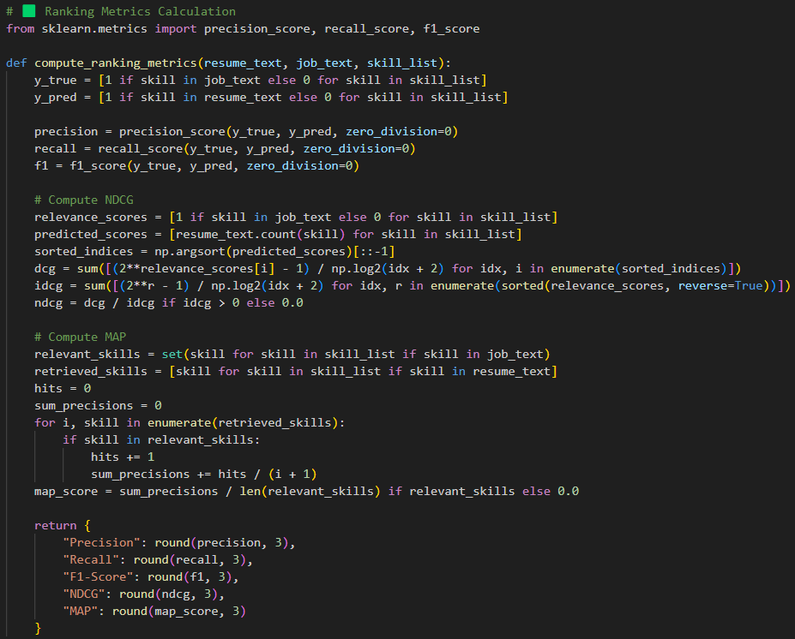
About team | Problem Statement | Project Overview | Dataset | Architecture | ML Model | Output | Conclusion
Ranking Metrices
Model Used:
Logistic Regression trained on cosine similarity threshold (Top match > 0.3 → 1 else 0)
Metrics Used:
Precision, Recall, F1-Score, MAP (Mean Average Precision),
NDCG (Normalized Discounted Cumulative Gain)
Functionality:
Compares presence of skills in resume vs job description
Calculates metrics per user interaction
Helps improve resume targeting & job fit

Slide 10
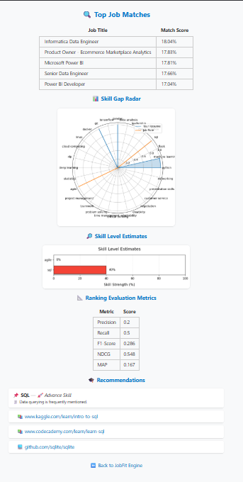
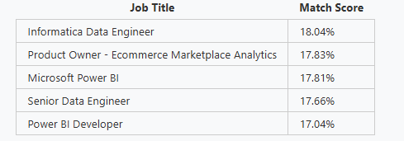
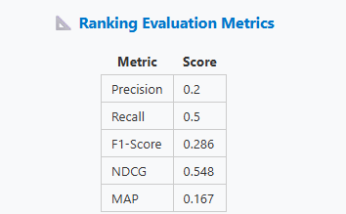
OUTPUT
About team | Problem Statement | Project Overview | Dataset | Architecture | ML Model | Output | Conclusion
What the Application Delivers
Shows top job matches based on your resume
Visual radar chart comparing your skills with job expectations
Bar chart showing your skill strength scores
Personalized skill recommendations with course/project links
Career path suggestions
Resume fit evaluation using real ranking metrics

Slide 11
About team | Problem Statement | Project Overview | Dataset | Architecture | ML Model | Output | Conclusion
What We Achieved
Built a full-stack ML + IR web app for resume-job matching
Integrated radar and bar chart visualizations for user insight
Developed skill-based recommendations
Incorporated advanced ranking metric evaluation
CONCLUSION
Challenges Faced
Handling inconsistent resume/job formats
Ensuring accurate skill extraction from text
Designing radar + bar charts for 20+ skills
Evaluation metrics integration without labeled dataset
Future Scope
Add PDF resume parser (like PyMuPDF)
Integrate GPT-based job/resume summarization
Deploy the app using Docker & host on cloud
Add feedback loop for model retraining using user ratings

Slide 12
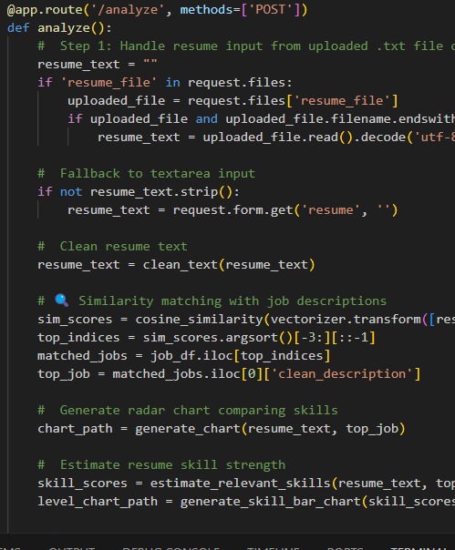
Thank You
https://github.com/muffinpuff11/JobFitEngine

